Slide 1
CAI
Fintan Foy,
Chief Executive Officer,
College of Anaesthetists of Ireland

Slide 2
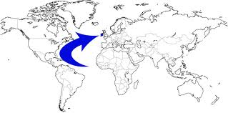
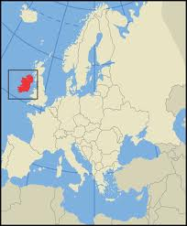
Ireland

Slide 3
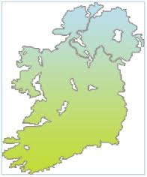
Ireland
Island which is a part of Europe
Strong history of Medical education
Population 4.5 million
Significant investment made in education and health
Education focused on quality and service

Slide 4
Medical Education in Ireland
6 undergraduate medical schools whose qualifications are recognised internationally
Established and internationally recognised developed post-graduate education programmes
Excellent capacity
Very well established links with Malaysia

Slide 5
Health Service Executive (HSE) & College of Physicians and Surgeons Pakistan (CPSP)
Overview of key principles
2 year training programme
2 years Training Credit on return to home country
Certificate of Completion issued only on return to home country
Entry visa to Ireland contingent on following guidelines of programme
Maintain CPSP log book
Minimum entry requirements agreed
Customised curriculum
Clinical Lead appointed for each specialty
Irish Medical Council Registration (Supervised Division – max. 2 years)
Visa to Ireland attached to IMC Registration
Access to full range of training services & resources e.g. Courses, Masterclasses

Slide 6
Recruitment & Selection
Nominated by Sponsoring Body
Skype Interviews after vetting applications
Irish Medical Council Registration/
Visa process
Induction Programme on arrival
Hospital Site Placement & Induction
Annual Training Body Assessment
Continuous Feedback

Slide 7
HSE/CPSP Scholarship Programme Summary of specialties
2013
Anaesthetics
General Surgery
2014
Anaesthetics
Obstetrics & Gynaecology
Number of Trainees
100 trainees in 2014
27 trainees in 2013
Emergency Medicine
General Surgery
Paediatrics
General Medicine
Emergency Medicine

Slide 8
Progress made in Year 2
Developed National Framework Guideline document for all International Medical Graduate Programmes in Ireland
Regular Steering Committee meetings
Project Manager appointed to manage:
Induction training
Point of contact for all legislative bodies in Ireland i.e. Irish Medical Council, Department of Immigration, Department of Justice
Co-ordinate & facilitate document requirements
Airport collection, accommodation, travel & logistical arrangements upon arrival.

Slide 9
Financials
HSE fund a monthly salary to trainees
HSE reimburse:
Cost of flights to Ireland
Irish Medical Council registration fees
Visa and work permit fees
Initial accommodation in Ireland
Refund of transfer costs to hospital base within Ireland

Slide 10
Opportunities for Specialist Medical Training in Ireland
WE CAN
Provide postgraduate specialist medical training across a broad range of medical, surgical, anaesthesia, radiology and other specialties to international medical graduates.
WE WILL
Focus on high quality specialist training
WE HAVE
Support from Minister of Health, Health Service Executive (HSE), Medical Council of Ireland (regulator), insurers and other Irish postgraduate training bodies.
Offer a “one-stop” shop of training opportunities.

Slide 11
What Training Are We Offering?
BST
RTP
HST
Fellowship Training
Training at the levels of:
Basic Specialist Training (BST)
Registrar Training Programme (RTP)
Higher Specialist Training (HST)
Fellowship Training

Slide 12
Training Available
Provided in Irish hospitals and clinical sites, which are currently approved for training in Ireland.
Established governance structure including Consultant medical supervision.
Structured training; curriculum-based; clear assessment strategy; certification.

Slide 13
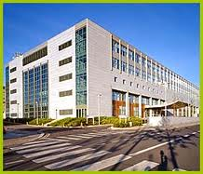
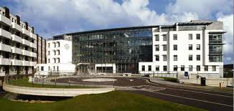
Benefits of the Irish Training Environment
Highly developed health and medical education system.
Highly professional and enthusiastic cohort of trained consultant, medical and other staff.
Excellent educational and hospital facilities, and supporting infrastructure, including E-learning.

Slide 14
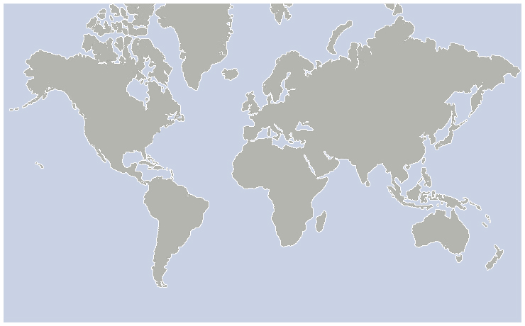
Training Bodies Overseas Communities
Omani Medical & Specialty Board
King Abdulaziz University, Jeddah
Ministry of Health, KSA
Kuwait Institute for Medical Specialisation
Hamad Medical Corporation,
Ministry for Health, Bahrain
Perdana University, Malaysia
Penang Medical School, Malaysia
Military Medical Academy, Egypt
Higher Committee for Medical Specialties,
Egypt
Notes:
14

Slide 15
CAI
THANK YOU

